Slide 1
Machine Learning Deep Unsupervised Learning
Semester Genap 2020/2021
Agung Toto Wibowo
Web: agungtoto.web.id
Email:agungtoto@telkomuniversity.ac.id

Slide 2
Introductions

Slide 3
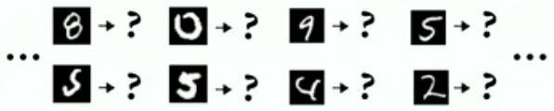
Unsupervised Learning
Learn from un-annotated data
Data Acquisition & and preparation are the larges part of real projects
if unsupervised learning works, it makes things a lot easier

Slide 4
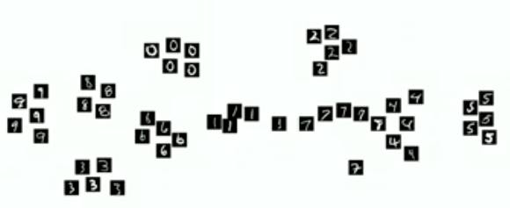
Unsupervised Learning
Clustering
Group similar data points
Detect out layer, explore, classify, ...
Using shallow learning algorithms such as k-means,

Slide 5

Unsupervised Learning
Separation Techniques
Find useful transformation of data
Which "Directions"/ dimensions are most important?
Detect out layers, reduce dimensionality, visualise, ...
PCA, SVD, Spectral transformations, Wavelets, …

Slide 6
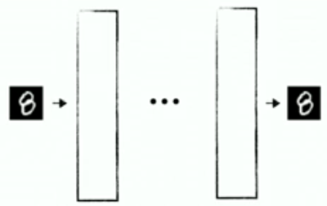
Unsupervised Learning
Autoencoders
Neural networks that reproduce their input
Use input as label

Slide 7
Machine Learning
Deep
Learning
Nature-Inspired Learning
(Swarm Intelligence)
Reinforcement Learning
Shallow Learning
Neural-Based
Learning
Unsupervised
Learning
Ensemble
Learning
Decision Tree
Learning
Bayesian
Learning
Support Vector
Machine

Slide 8
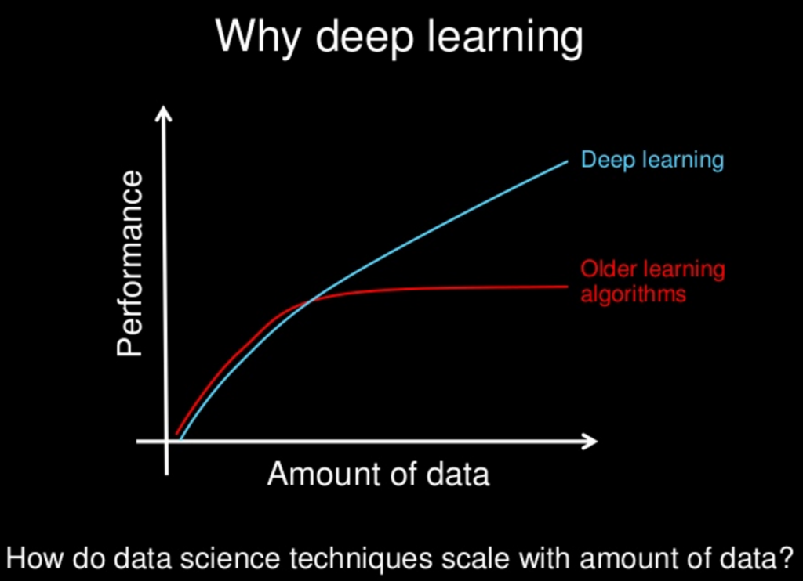
Deep Learning
Human
Shallow Learning

Slide 9
Restricted Boltzmann Machine (RBM) and Deep Restricted Boltzmann Networks

Slide 10
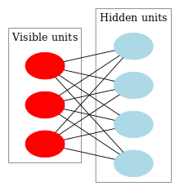
Restricted Boltzmann Machines (RBM)
An undirected graphical model, initially introduced as Harmonium by Paul Smolensky in 1986. Gained big popularity in recent years in the context of the Netflix Prize
RBMs have found applications in :
dimensionality reduction,
classification,
collaborative filtering,
feature learning,
topic modelling.

Slide 11
Restricted Boltzmann Machines (RBM)
Uses stochastic units with particular distributions instead of deterministic distribution
Task is to find out how these two sets of variables are actually connected each other
Might has two biases:
The hidden bias helps RBM produce the activation on the forward pass
The visible layer’s biases help the RBM learn the reconstructions on the backward pass

Slide 12
Restricted Boltzmann Machines (RBM)
RBMs are shallow, two layer neural network (visile layer and hidden layer)
Each circle represents a neuron-like unit called a node.
The nodes are connected to each other across layers, but no two nodes of the same layer are linked.

Slide 13
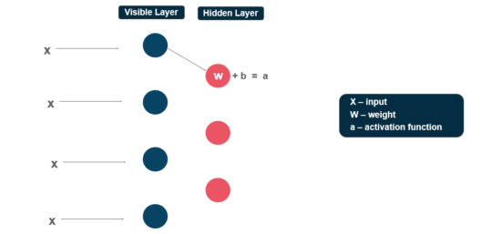
Restricted Boltzmann Machines (RBM)
Each visible node takes a low-level feature from an item in the dataset.
At node 1 of the hidden layer, x is multiplied by a weight and added to a bias.
And fed the result into an activation function,
produces the node’s output, or
the strength of the signal.

Slide 14
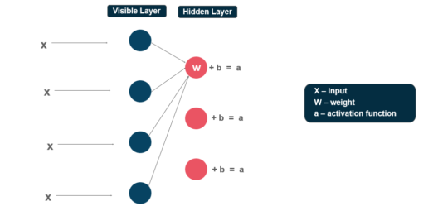
Restricted Boltzmann Machines (RBM)
Next, several inputs would combine at one hidden node.
Each x is multiplied by a separate weight,
The products are summed, added to a bias, and
The result is passed through an activation function to produce the node’s output.

Slide 15
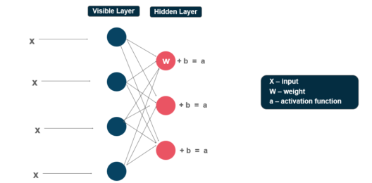
Restricted Boltzmann Machines (RBM)
At each hidden node, each input x is multiplied by its respective weight w.
A single input x would have three weights here, making 12 weights altogether (4 input nodes x 3 hidden nodes).
The weights between the two layers will always form a matrix where:
the rows are equal to the input nodes,
the columns are equal to the output nodes.

Slide 16
Restricted Boltzmann Machines (RBM)
Each hidden node receives the four inputs multiplied by their respective weights.
The sum of those products is again added to a bias (which forces at least some activations to happen), and
the result is passed through the activation algorithm producing one output for each hidden node.

Slide 17
Restricted Boltzmann Machines (RBM)
Training of Restricted Boltzmann Machine
Differs from the training of regular neural networks via stochastic gradient descent
Two main training steps:
Gibs sampling
Contrastive Divergence step

Slide 18
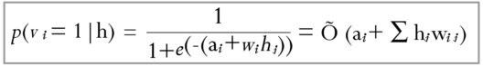
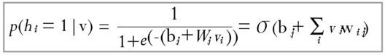
Gibbs Sampling
Given an input vector v we use p(h|v) for prediction of the hidden values h. Knowing the hidden values we use p(v|h) :
for prediction of new input values v. This process is repeated k times. After k iterations, we obtain another input vector v_k which was recreated from original input values v_0.

Slide 19
Contrastive Divergence step
The update of the weight matrix happens during the Contrastive Divergence step.
Vectors v_0 and v_k are used to calculate the activation probabilities for hidden values h_0 and h_k :

Slide 20
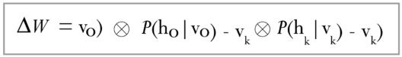
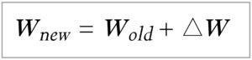
Contrastive Divergence step
The difference between the outer products of those probabilities with input vectors v_0 and v_k results in the updated matrix :
Using the update matrix the new weights can be calculated with gradient ascent, given by:

Slide 21
Restricted Boltzmann Machines (RBM)

Slide 22
Deep Restricted Boltzmann Networks
Kita bisa membangun DRBN dengan lima lapisan, puluhan, ratusan atau bahkan ribuan lapisan RBM.
Pada lapisan pertama, kita akan mendapatkan fitur level rendah. Pada lapisan selanjutnya, kita akan mendapatkan fitur dengan level yang lebih tinggi dan semakin tinggi, hingga di lapisan terakhir kita akan mendapatkan fitur dengan level tertinggi.
Nah, fitur dengan level tertinggi inilah yang bisa membedakan antar kelas (label) secara mudah.
Fitur level tertinggi ini bisa menjadi masukan untuk model klasifikasi apapun, seperti Naïve Bayes Classifier, Decision Tree Classifier, dsb.
Jadi, DRBN bisa dianggap sebagai model perekayasaan fitur (feature engineering) yang mengubah data mentah menjadi fitur-fitur penting yang memiliki kemampuan tinggi dalam membedakan antar kelas (label).

Slide 23
Autoencoders and Stacked Autoencoders

Slide 24

Autoencoders
Neural networks that reproduce their input
Use input as output

Slide 25
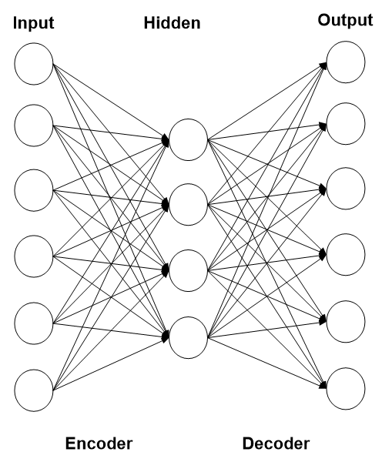
Autoencoders
Perceptron
Autoencoders networks

Slide 26
PCA – Dimensionality Reductions

Slide 27
Autoencoders – Dimensionality Reductions

Slide 28
Stacked Autoencoders

Slide 29
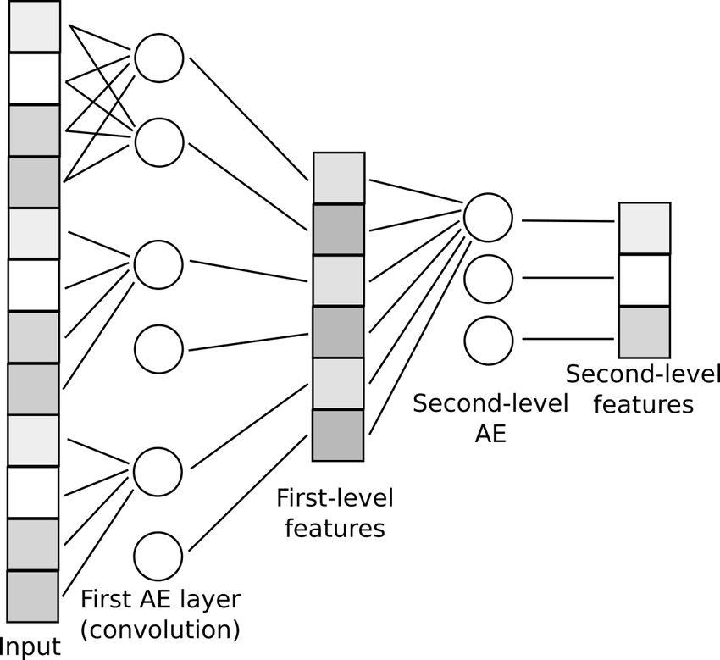
Stacked Autoencoders

Slide 30
Stacked Autoencoders

Slide 31
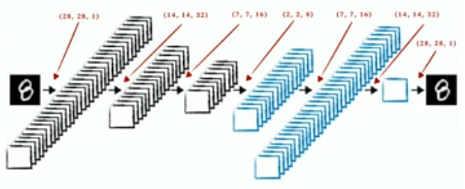
Stacked Autoencoders on Image
In image, convolution performs better than fully connected
MNIST: 97,5% vs 87,5%
Convolution and deconvolution (transpose convolution)

Slide 32
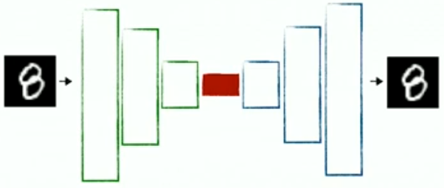
The Bottleneck
(Much) smaller dimension than input
forces net to "squeeze" information from input
Splits network into encoder & decoder

Slide 33
The Bottleneck
(Much) smaller dimension than input
forces net to "squeeze" information from input
Splits network into encoder & decoder

Slide 34
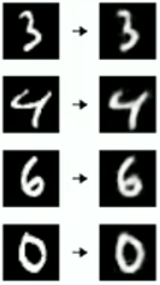
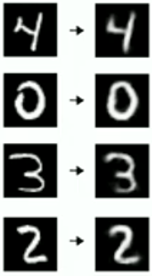
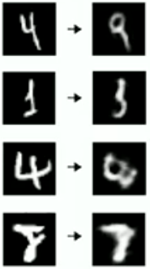
Examples
Examples
Not just blurred, reconstructed
unusual images get worse reconstructions

Slide 35
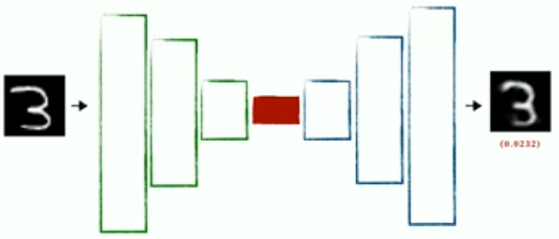
Usecase 1: Anomaly Detections
Note max error on validation data (0.04)
Keep Autoencoder as is, use it on productions data
if eror in productions > 0.04 - we have anomaly

Slide 36
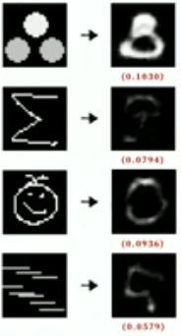
Usecase 1: Anomaly Detections
Useful for unbalanced classes
Useful to detect outliers in training data
Useful if we do not know what "wrong" or "broken" means
Useful if negative data is expensive to produce
No annotation necessary!

Slide 37
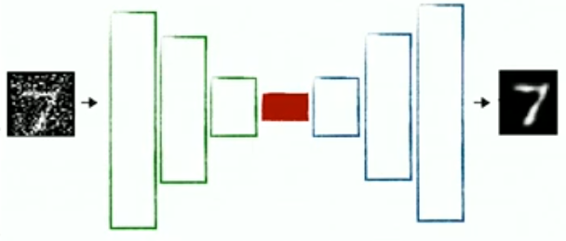
Use Case 2: Denoising
Add noise to input, train against clean, original input
Sometimes bottleneck has to be larger than input

Slide 38
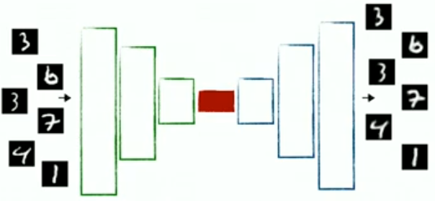
Use Case 3: Pretraining
Case: We have a lot of data, but only a bit is annotated
Train encoder and decoder on un-annotated data (as before)

Slide 39
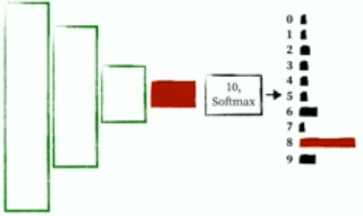
Use Case 3: Pretraining
Attach classifier layer
Continue Supervised training on smaller annotated dataset
Semi-supervised training = (pretraining + transfer training)

Slide 40
Use Case 4: Similarity Detections
Like Pretraining
Train encoder and decoder on un-annotated data (as before)

Slide 41
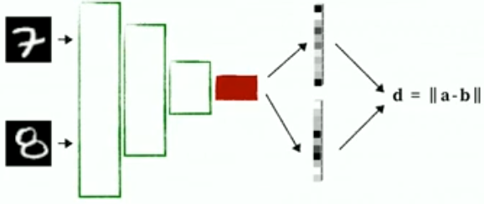
Use Case 4: Similarity Detections
Do not attach anything
Calculate bottleneck output vectors for two data points (feature vectors, latent vectors, embedding vectors, ...)
Distance of vectors = distance of inputs

Slide 42
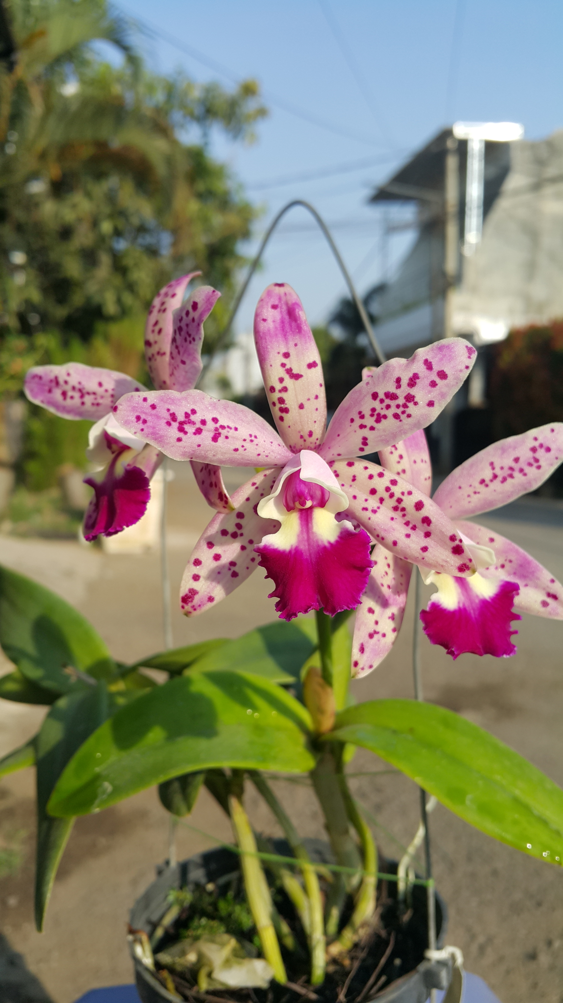
Questions?

Slide 43
Referensi Slide
Suyanto, dkk, “Deep Learning: Modernisasi Machine Learning untuk Big Data”
Chirstoph Heinkeimann, "Unsupervised Learning with Autoencoders" presentations on Machine Learning Conference
https://en.wikipedia.org/wiki/Restricted_Boltzmann_machine
https://medium.com/edureka/restricted-boltzmann-machine-tutorial-991ae688c154

